Slide 1
Advanced Topics
WEB SCIENCES
Etienne Raquin
23.07

Slide 2
Introduction

Slide 3


Introduction
“If you’re crazy about Strava”
- Dr. Koumpis, 14.05.2019

Slide 4
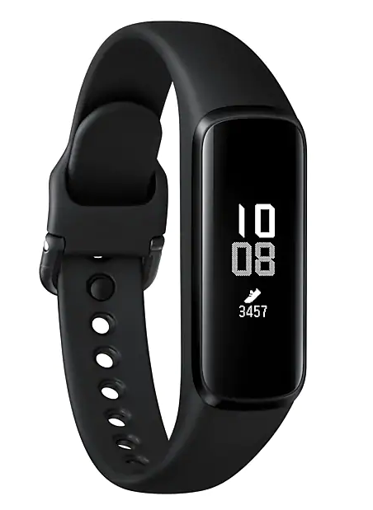
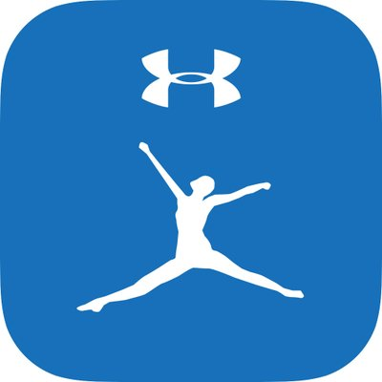
Introduction
MyFitnessPal
http://twitter.com/myfitnesspal
Samsung Galaxy Fit
http://www.samsung.com

Slide 5
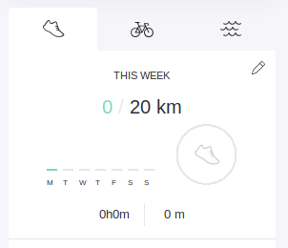
Introduction

Slide 6
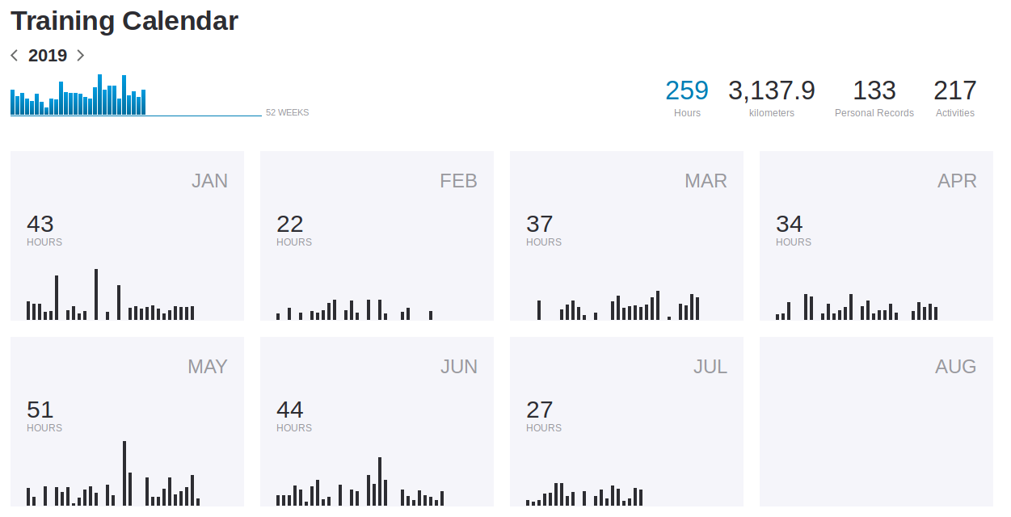
Introduction

Slide 7
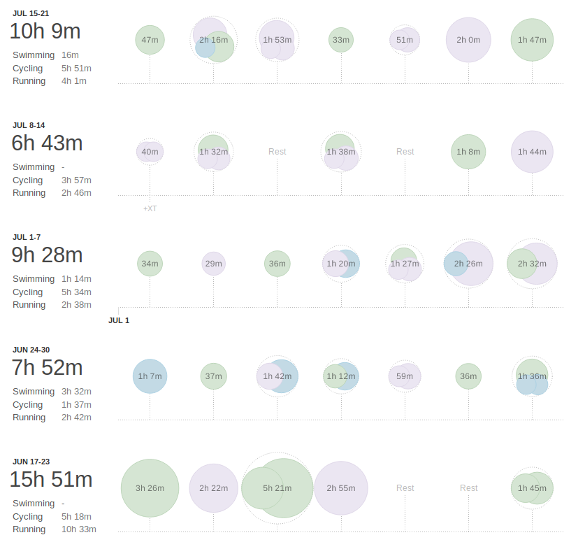
Introduction

Slide 8
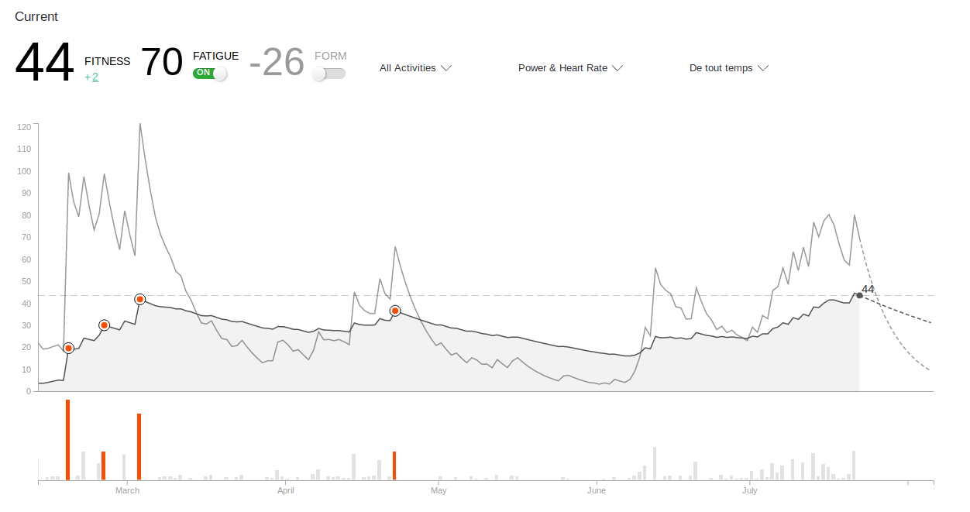
Introduction

Slide 9
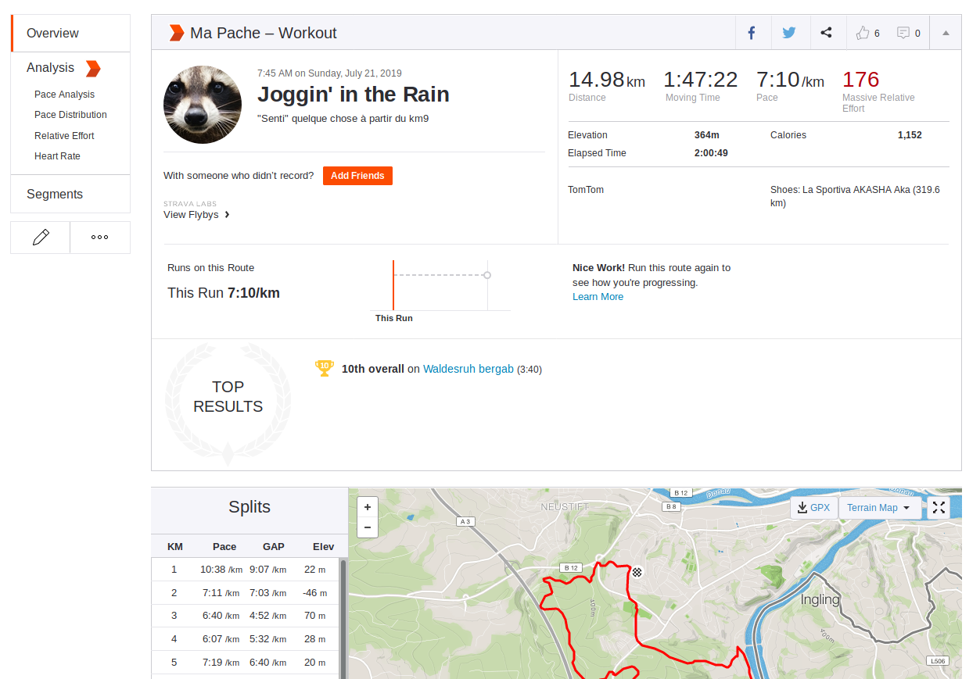
Introduction

Slide 10
Objective

Slide 11
Objective
Detect Overtraining from an Activity GPX File

Slide 12
Process

Slide 13
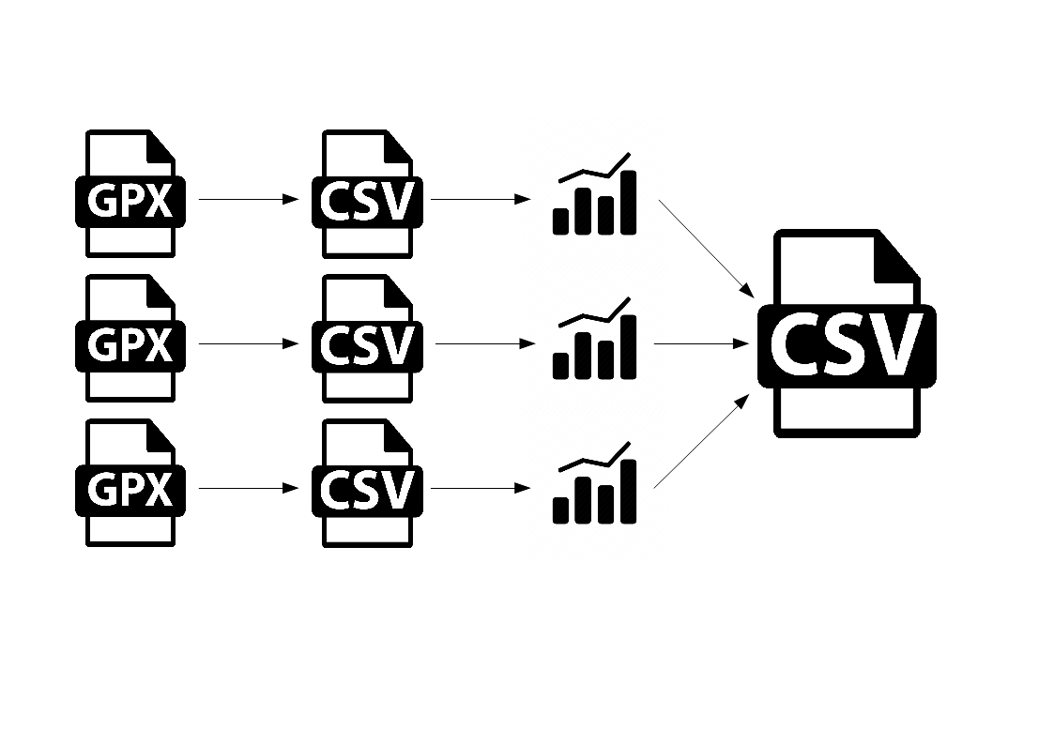
Process

